Slide 1




G.H. RAISONI COLLEGE OF ENGINEERING
AND MANAGEMENT, WAGHOLI, PUNE.
Department of AI & AIML
Location Based Reminder App
Guide:
Prof. Pranita Mokal
Name of Projectees
1.Ashlesha Hajare(65) 2.Nikita Gaikwad (67)
3.Aditya Wagh (68) 4.Roshani Shaikh (69)

Slide 2
Contents
Introduction
Justifications for Selecting the Title
Problem Statement
Literature Survey
Block Diagram
Expected Result
Work plan
References

Slide 3
Introduction
Location-based reminders that remind you to do something when you arrive at, or leave, a specific location.
The main purpose of location-based services is to provide services to customers based on the knowledge of their locations.
The aim is to be able to remind the user of certain tasks which are specific to one point only. People often forget to pick up certain items when they pass right by the shop
The app uses the GPS capabilities of smartphones to pinpoint the user's location accurately.
Users can set reminders for various tasks, such as grocery shopping, picking up dry cleaning, or calling someone, and tie them to specific locations like supermarkets, dry cleaning stores, or home.
When the user approaches or leaves the designated location, the app sends a notification, reminding them of the task. This ensures that important tasks are not forgotten and are attended to at the right place and time

Slide 4
Problem Statement
Problem Statement:
We add reminder on the basis of
1.Traditional paper based Reminder.
2.Task which is Time based
3. Task which is Location based
based In “Time based tasks” the task which is starting at a specific time e.g. Meeting this is scheduled at 11 AM. We set reminders in our mobile for the same.
On the other hand, in “Location based reminder” the task to be performed at specific location

Slide 5
Justification For Selecting The Title
1.Relevance: Location-based reminder apps are increasingly popular in today's mobile-centric world. They address a practical need – helping users remember tasks based on their location, making them relevant to a wide audience.
2.Practical Application: These apps have practical applications in daily life, from reminding users to buy groceries when they are near a supermarket to reminding them to pick up their dry cleaning when they are close to the cleaners.
3.Technological Integration: Location-based reminder apps often incorporate advanced technologies like GPS and geofencing, making them interesting from a technological standpoint. Discussing these technologies can be insightful for tech enthusiasts and developers
GOOGLE MAP API : Google map API is the revolutionary launch among the Google products. Most of the location based applications are built by using this API to visualize the geospatial information on top of the customized map. It provides the ability to the developer not only to the experts to create their own map. During implementation this paper, Google Map API is used to create a geographical representation of the user’s position mapped with the tasks.
GPS :GPS means "Global Positioning System". GPS is receiving information from satellite that information used to track location. GPS use three dimensions: latitude, longitude and altitude.
Geofencing: For each task with an associated location, the app sets up a geofence around that location. A geofence is a virtual perimeter around a geographic area. The app uses the geofencing API to monitor whether the user enters or exits the geofenced area associated with a task.

Slide 6
Literature Survey
Sr. No. | Paper Title and its Author | Details of Publication | Findings
1 | Kumar, Sukhwant and Bhowmik, Sudipa and Malakar, Priyanka and Sen, Pushpita, Task Reminder and Messaging Application | (I-REM) (April 23, 2021). | The section deals with the essence of the preceding findings related to the formulated work and comprehensive analysis of the same for prospective upshot.
2 | Neha Kumari, Mr. Saurabh Anand A REVIEW PAPER ON SMART REMINDER APPLICATION WITH GPS SYSTEM | ISSN NO : 2249-7455 Volume 8, Issue V, MAY/2018 | A Location-based Personal Task Management Application.

Slide 7
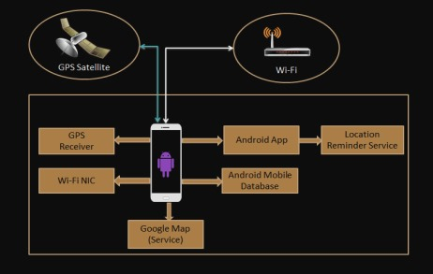
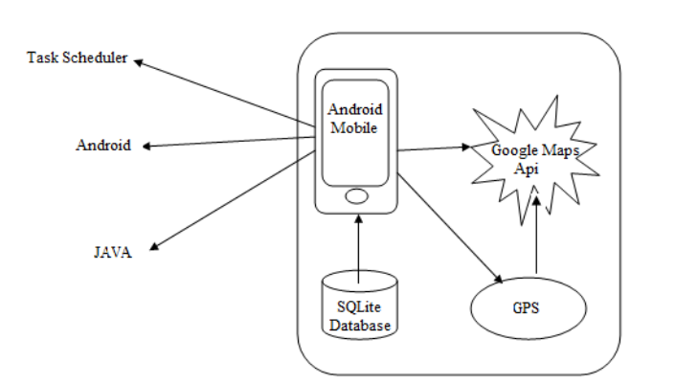
Block Diagram
Fig 1. Component Diagram
Fig 2. Architecture
The device utilizes Google Maps for location searching when setting tasks. GPS is employed to track the device's location. The Task Scheduler is responsible for scheduling tasks based
on both time and location. SQLite Database serves as the storage system on Android devices
to retain data.

Slide 8
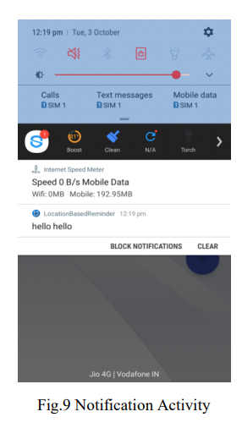
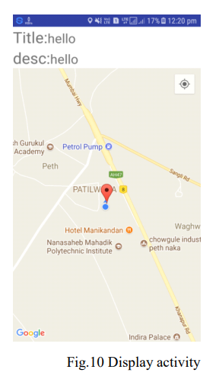
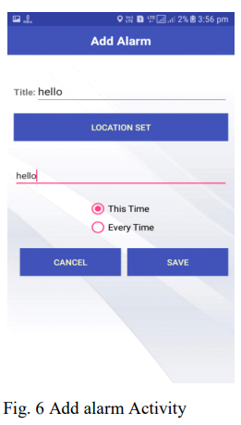
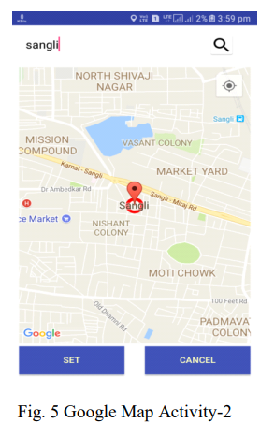
Expected Result
Create a user-friendly Android app for location-based reminders with accurate geofencing and map integration.
Deliver timely notifications and personalized settings for an efficient and user-focused experience.

Slide 9
Work – Plan
Months Activities | August’23 | Sept’23 | Oct’23 | Nov’23
Literature Reviews | √
Requirement Analysis | √
Designing | √
Experimental Analysis | √ | √ | √
Module wise Implementation |  | √ | √
Testing and Debugging |  |  | √ | √
Preparation of Project Report |  |  |  | √

Slide 10
References
[1] Reto Mier, “Professional Android Application Development”.
[2] T. Sohn, et al., "Place-Its: A Study of LocationBased Reminders," in UbiComp, 2005, p. 19.
[3] www.gps.gov/applications/survey
[4] Reto Mier, “Professional Android Application Development”.
[5] U. Government. (1999), Global Positioning System. www.gps.gov

Slide 11
Thank you !

